Slide 1
The Cuban Missile Crisis
Institutional Affiliation
Instructor
Course code
Date of submission

Slide 2
Introduction
During the period of the Cuban missile crisis, leaders of the US and the USSR engaged in a tense 13-day political and military standoff over the installation of nuclear missiles by the soviet union in Cuba (Nathan 2016).
President J. Kennedy after confirming the presence of the missiles decided to enact a naval blockade around Cuba, an indication that the US was prepared for military engagement if needed to neutralize the threat posed by the USSR.
The tough standoff however ended when the US agreed to the USSR’s offer to remove the military missiles in exchange of an a promise by the US not to attack Cuba. It is argued that there was a secret agreement by Kennedy to remove US missiles from Turkey.

Slide 3
Discovery of the missiles
In October 1962, an American U-2 spy plane secretly photographed nuclear missile sites being built by the Soviet Union on the island of Cuba.
President Kennedy did not want the Soviet Union and Cuba to know that he had discovered the missiles
Such missiles could hit much of the eastern United States within a few minutes if launched from Cuba. After carefully considering the alternatives of an immediate U.S. invasion of Cuba (or air strikes of the missile sites), a blockade of the island, a naval quarantine was decided upon (Karlsson, & Acosta, 2019).

Slide 4
Origin of the Cuban missile Crisis
The origin of the Cuban Missile Crisis lies in the failed invasion of the Bay Pigs in which the US-supported Cuban exiles who hoped to wage an uprising against the Cuban president Castro and were overpowered by the Cuban armed forces.
After this invasion, Castro turned to the Soviet Union seeking for protection against any possible US aggression (Nathan 2016).
The USSR had promised to protect Cuba, providing her with nuclear weapons on the condition that it would remain a secret until the installation of the missiles was complete.
Ideally, the soviet union leadership saw this as an opportunity to alter the global balance of power in their favor.

Slide 5
Negotiation of a peaceful outcome
Khrushchev had initially refused to acknowledge the presence of missiles in Cuba and subsequently declared the naval blockade initiated by the US as a daring act of war, he however acknowledged the presence of these missiles further ordering for a suspension of all weapon deliveries on transit to Cuba (Karlsson, & Acosta, 2019).
Over a period of two weeks, the two leaders were engaged in a discussion trying to negotiate a peaceful outcome to the missile crisis.
During the negotiation process, the soviet union compared their provision of the nuclear weapons to Cuba with the sanctioning of the Jupiter missiles by the US in Turkey, which were also of the soviet union’s territories.

Slide 6
CONT…
President Kennedy agreed to remove these missiles with a further pledge not to undertake any further invasion of Cuba.
White (2016) noted that during these negotiations, Castro was never consulted, an indication that the soviet union valued their relations with the US over that of their ally.
Castro had previously hoped that the negotiation would close the US naval base at Guantanamo and the subsequent cessation of U-2 flights over Cuba, however even though all nuclear missiles were removed from Cuba, there was no mention of the topic as thought by Castro.

Slide 7
Consequences of the Cuban Missile Crisis
Despite the fact the soviet union attempted to proclaim victory as the main outcome of the missile crisis. One of the major consequences of the crisis was the ouster of Khrushchev who was forced into mandatory retirement due to his reckless decisions and the inability to effectively lead the soviet union (Peltonen, 2019).
Other soviet union leaders claimed that the missile crisis was enough proof of Khrushchev’s incompetence. Besides, Leonid Brezhnev came to power and tried to reduce the existing tensions between the two states (Karlsson, & Acosta, 2019).
Similarly, throughout the negotiations, J.F. Kennedy was regarded as a great statesman who stood his firm ground. Essentially, the Cuban missile crisis remains to be a singular event during the period of cold war that strengthened Kennedy’s image locally and internationally.

Slide 8
CONT…
Having come too close to the occurrence of a nuclear war, the two nations began to reconsider the global nuclear arms race, subsequently agreeing to take the initial steps towards the ban of the nuclear weapons through the nuclear Test Ban Treaty(White 2016)
China saw the crisis as the Soviet union’s weakness and therefore distance itself from them.
Consequently, the US gained a lot of confidence subsequently entering wars in Nicaragua, Grenada and Vietnam boldly in various attempts to overpower communism (Peltonen, 2019).

Slide 9
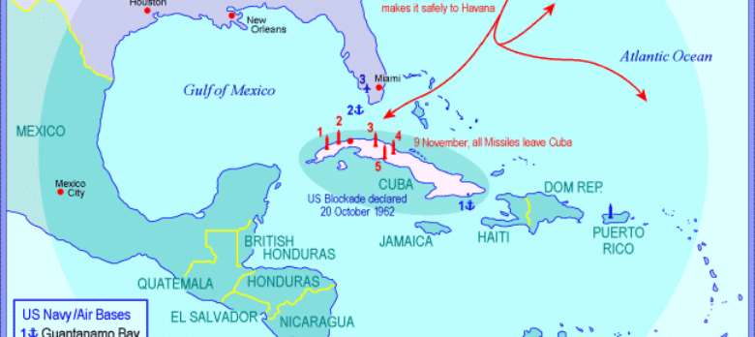
An image showing the Cuban Missile Crisis plan

Slide 10
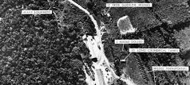
An image showing the nuclear assembly point.

Slide 11
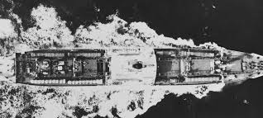
An image of the US naval blockade.

Slide 12
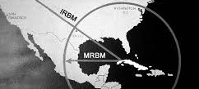
An image showing the possible area covered by the missile.

Slide 13
References
Nathan, J. (Ed.). (2016). The Cuban missile crisis revisited. Springer.
Peltonen, T. (2019). Case Study 1: Wise Leadership During the Cuban Missile Crisis. In Towards Wise Management (pp. 69-102). Palgrave Macmillan, Cham.
Karlsson, H., & Acosta, T. D. (2019). The Missile Crisis from a Cuban Perspective: Historical, Archaeological and Anthropological Reflections. Routledge.
Heller, J. (2016). Kennedy, Israel and the Cold War before the Cuban Missile Crisis (1961–62). In The United States, the Soviet Union and the Arab–Israeli conflict, 1948–67. Manchester University Press.
White, M. (2016). Reflection on; Robert Kennedy and the Cuban Missile Crisis: A Reinterpretation. American Diplomacy, 1-2.

